Slide 1

ECE 2700
Digital Circuits
Adders
Copyright © 2010 Frank Vahid
Instructors of courses requiring Vahid's Digital Design textbook (published by John Wiley and Sons) have permission to modify and use these slides for customary course-related activities, subject to keeping this copyright notice in place and unmodified. These slides may be posted as unanimated pdf versions on publicly-accessible course websites.. PowerPoint source (or pdf with animations) may not be posted to publicly-accessible websites, but may be posted for students on internal protected sites or distributed directly to students by other electronic means. Instructors may make printouts of the slides available to students for a reasonable photocopying charge, without incurring royalties. Any other use requires explicit permission. Instructors may obtain PowerPoint source or obtain special use permissions from Wiley – see http://www.ddvahid.com for information.

Slide 2
Today’s Objective
To understand how to design and use an adder

Slide 3
Adders
Adds two N-bit binary numbers
  2-bit adder: adds two 2-bit numbers, outputs 3-bit result
  Example: 01 + 11 = 100
  (1 + 3 = 4)
Can design using combinational design process of, but doesn’t work well
  Why not?
Inputs
Outputs
a1
a0
b1
b0
c
s1
s0
0
0
0
0
0
0
0
0
0
0
1
0
0
1
0
0
1
0
0
1
0
0
0
1
1
0
1
1
0
1
0
0
0
0
1
0
1
0
1
0
1
0
0
1
1
0
0
1
1
0
1
1
1
1
0
0
1
0
0
0
0
1
0
1
0
0
1
0
1
1
1
0
1
0
1
0
0
1
0
1
1
1
0
1
1
1
0
0
0
1
1
1
1
0
1
1
0
0
1
1
1
0
1
0
1
1
1
1
1
1
1
0

Slide 4
Adders: Combinational Design Process
Truth table too big
  8-bit adder: 2⁽⁸⁺⁸⁾ = 65,536 rows
  16-bit adder: 2⁽¹⁶⁺¹⁶⁾ = ~4 billion rows
  Too many gates needed
10000
8000
Transistors
6000
4000
2000
0
1
2
3
4
5
6
7
8
N

Slide 5
Alternative Method: Imitate Adding By Hand
Mimic how we do addition by hand
  One column at a time
  Compute sum, add carry to next column
0
1
0
1
1
1
A:
1 1 1 1
1 1 1 1
1 1 1 1
1 1 1 1
B:
+ 0 1 1 0
+ 0 1 1 0
+ 0 1 1 0
+ 0 1 1 0
1
0
1
1
0
1
1
0
1
0
1
How do we implement this idea?

Slide 6

Designing An Adder
Create component for each
column
  Adds that column’s bits,
  generates sum and
  carry bits
1
1
0
A:
1 1 1 1
B:
+ 0 1 1 0
1
0
1
0
1
1
1
0
A:
1
1
1
1
+
B:
0
1
1
0
b
a
ci
b
a
ci
b
a
ci
b
a
c
o
s
c
o
s
c
o
s
c
o
s
1
0
1
0
1
SUM
Full-adders
Half-adder

Slide 7
Half-Adder (HA)
Adds 2 bits, generates sum and carry
1
1
0
Step 1: Capture the function
A:
1
1
1
1
+
B:
0
1
1
0
I
nputs
O
utputs
b
a
ci
b
a
ci
b
a
ci
b
a
a
b
co
s
c
o
s
c
o
s
c
o
s
c
o
s
0
0
0
0
1
0
1
0
1
0
1
0
1
SUM
1
0
0
1
1
1
1
0
Step 2B: Implement as circuit
Step 2A: Create equations
a
b
co = ab
s = a’b + ab’ (same as s = a xor b)
a
b
Half-adder (HA)
co
s
co
s

Slide 8
Full-Adder (FA)
1
1
0
Adds 3 bits, generates sum
and carry
A:
1
1
1
1
+
B:
0
1
1
0
I
nputs
O
utputs
a
b
ci
co
s
b
a
ci
b
a
ci
b
a
ci
b
a
c
o
s
c
o
s
c
o
s
c
o
s
0
0
0
0
0
1
0
1
0
1
SUM
0
0
1
0
1
0
1
0
0
1
0
1
1
1
0
1
0
0
0
1
a
b
ci
1
0
1
1
0
1
1
0
1
0
1
1
1
1
1
co = a’bc + ab’c + abc’ + abc
co = a’bc + abc + ab’c + abc + abc’ + abc
co = (a’ + a) bc + (b’ + b) ac + (c’ + c) ab
co = bc + ac + ab
s = a’b’c + a’bc’ + ab’c’ + abc
s = a’(b’c + bc’) + a(b’c’ + bc)
s = a’ (b xor c)’ + a (b xor c)
s = a xor b xor c
Full adder (FA)
c
o
s

Slide 9

Carry-Ripple Adder
Common misconception:
A carry-ripple adder is not the same as a full-adder. A number of full-adders are put together to create a carry-ripple adder
Using half-adder and full-adders, we can build adder that adds like we would by hand
  Called a carry-ripple adder
  4-bit adder shown
    Adds two 4-bit numbers, generates 5-bit output
    5-bit output can be considered 4-bit “sum” plus 1-bit “carry out”
  Can easily build any size adder
a3
b3
a2
b2
a1
b1
a0
b0
a
b
ci
a
b
ci
a
b
ci
a
b
a3
a2
a1
a0
b3
b2
b1
b0
F
A
F
A
F
A
HA
4-bit adder
c
o
s
c
o
s
c
o
s
c
o
s
c
o
s3
s2
s1
s0
c
o
s3
s2
s1
s0

Slide 10
Carry-Ripple Adder’s Behavior
0
0
0
0
0
0
0
0
0
0
0
0
a
b
ci
a
b
ci
a
b
ci
a
b
ci
F
A
F
A
F
A
F
A
Assume all inputs initially 0
c
o
s
c
o
s
c
o
s
c
o
s
0
0
0
0
0
0
0
0
0
0
0
1
0
0
1
0
0
1
1
0
0111+0001
(answer should be 01000)
a
b
ci
a
b
ci
a
b
ci
a
b
ci
F
A
F
A
F
A
F
A
c
o
s
c
o
s
c
o
s
c
o
s
0
0
1
0
0
0
c
o2
1
c
o1
1
c
o0
0
O
utput a
f
t
er 2 ns (1
F
A del
a
y)
Wrong answer—is there a problem? No—just need more time for carry to ripple through the chain of full adders

Slide 11
Carry-Ripple Adder’s Behavior
0
0
0
1
0
0
1
0
1
1
1
0
0111+0001
(answer should be 01000)
a
b
ci
a
b
ci
a
b
ci
a
b
ci
F
A
F
A
F
A
F
A
c
o
s
c
o
s
c
o
s
c
o
s
0
1
1
c
o1
0
0
Outputs after 4ns (2 FA delays)
0
0
1
0
1
1
0
1
1
0
0
1
0
a
b
ci
a
b
ci
a
b
ci
a
b
ci
F
A
F
A
F
A
F
A
c
o
s
c
o
s
c
o
s
c
o
s
1
1
1
c
o2
0
0
0
Outputs after 6ns (3 FA delays)
0
0
1
1
0
1
1
0
1
1
1
0
0
a
b
ci
a
b
ci
a
b
ci
a
b
ci
F
A
F
A
F
A
F
A
c
o
s
c
o
s
c
o
s
c
o
s
1
1
1
0
1
0
0
0
Output after 8ns (4 FA delays)
Correct answer appears after 4 FA delays

Slide 12
Carry-Ripple Adder
Using FA instead of HA for the first bit, we can include a “carry in” bit in the addition
  Useful later when we connect smaller adders to form bigger adders
a3
b3
a2
b2
a1
b1
a0
b0
ci
a
b
ci
a
b
ci
a
b
ci
a
b
ci
a3
a2
a1
a0
b3
b2
b1
b0
F
A
F
A
F
A
F
A
4-bit adder
ci
c
o
s
c
o
s
c
o
s
c
o
s
c
o
s3
s2
s1
s0
c
o
s3
s2
s1
s0

Slide 13
Cascading Adders
How do you build an 8-bit adder from 4-bit adders?
a3
a2
a1
a0
b3
b2
b1
b0
4-bit adder
ci
c
o
s3
s2
s1
s0
a7
a6
a5
a4
b7
b6
b5
b4
a3
a2
a1
a0
b3
b2
b1
b0
a3
a2
a1
a0
b3
b2
b1
b0
a3
a2
a1
a0
b3
b2
b1
b0
a7.. a0
b7.. b0
4-bit adder
ci
4-bit adder
ci
8-bit adder
ci
+
co
s3
s2
s1
s0
co
s3
s2
s1
s0
co
s7.. s0
co
s7
s6
s5
s4
s3
s2
s1
s0
C
Block symbol
Simplified
block symbol

Slide 14
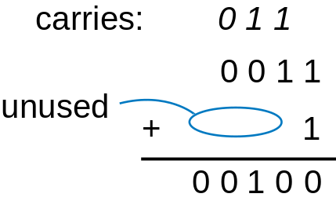
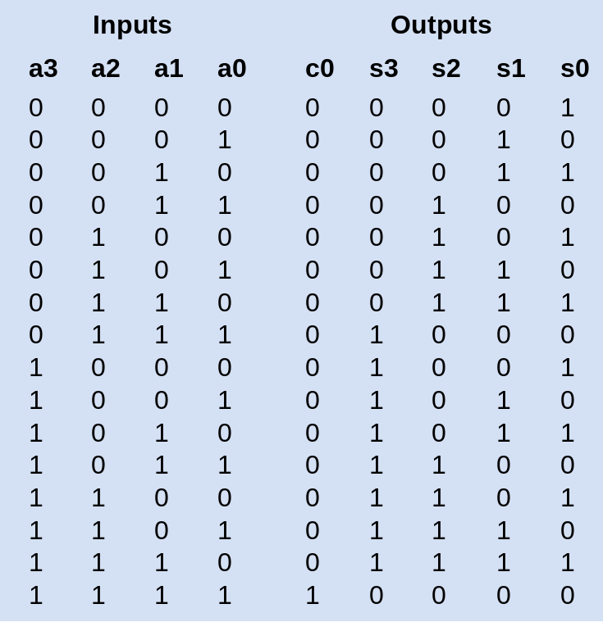
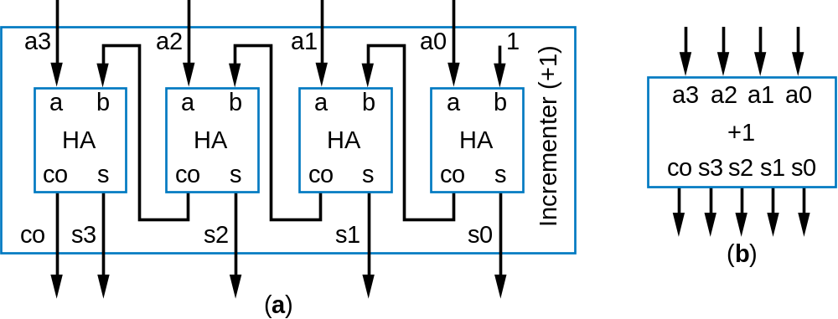
Designing An Incrementer
Add 1 to input

Slide 15
Design Example: BCD Adder
What’s BCD?
  Binary-coded decimal
  A class of encoding in which each decimal digit is represented by some fixed number of bits
    Usually 4 or 8 bits are used

Slide 16
Binary-Coded Decimal
(12)₁₀
(1100)₂
00010010
Coding
(using BCD code
for each digit)

Slide 17
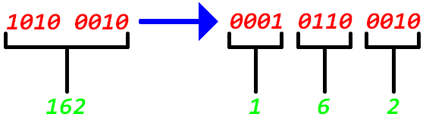
More Example

Slide 18
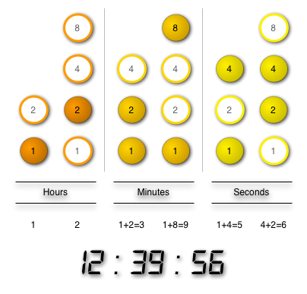
More Example

Slide 19
Design
BCD adder
  Adding 2 BCD numbers together
Range
  Min: 0 + 0 = 0
  Max: 9 + 9 = 18, plus 1 for carry-in
    So Max is 19

Slide 20
BCD Truth Table (0-9)
Number | C | S8 | S4 | S2 | S1
0 | 0 | 0 | 0 | 0 | 0
1 | 0 | 0 | 0 | 0 | 1
2 | 0 | 0 | 0 | 1 | 0
3 | 0 | 0 | 0 | 1 | 1
4 | 0 | 0 | 1 | 0 | 0
5 | 0 | 0 | 1 | 0 | 1
6 | 0 | 0 | 1 | 1 | 0
7 | 0 | 0 | 1 | 1 | 1
8 | 0 | 1 | 0 | 0 | 0
9 | 0 | 1 | 0 | 0 | 1
Same as in binary

Slide 21
BCD Truth Table (10-19)
Number | C | S8 | S4 | S2 | S1
10 | 1 | 0 | 0 | 0 | 0
11 | 1 | 0 | 0 | 0 | 1
12 | 1 | 0 | 0 | 1 | 0
13 | 1 | 0 | 0 | 1 | 1
14 | 1 | 0 | 1 | 0 | 0
15 | 1 | 0 | 1 | 0 | 1
16 | 1 | 0 | 1 | 1 | 0
17 | 1 | 0 | 1 | 1 | 1
18 | 1 | 1 | 0 | 0 | 0
19 | 1 | 1 | 0 | 0 | 1

Slide 22
BCD Truth Table (10-19)
BCD
Binary
# | C | S8 | S4 | S2 | S1
10 | 1 | 0 | 0 | 0 | 0
11 | 1 | 0 | 0 | 0 | 1
12 | 1 | 0 | 0 | 1 | 0
13 | 1 | 0 | 0 | 1 | 1
14 | 1 | 0 | 1 | 0 | 0
15 | 1 | 0 | 1 | 0 | 1
16 | 1 | 0 | 1 | 1 | 0
17 | 1 | 0 | 1 | 1 | 1
18 | 1 | 1 | 0 | 0 | 0
19 | 1 | 1 | 0 | 0 | 1
K | Z8 | Z4 | Z2 | Z1
0 | 1 | 0 | 1 | 0
0 | 1 | 0 | 1 | 1
0 | 1 | 1 | 0 | 0
0 | 1 | 1 | 0 | 1
0 | 1 | 1 | 1 | 0
0 | 1 | 1 | 1 | 1
1 | 0 | 0 | 0 | 0
1 | 0 | 0 | 0 | 1
1 | 0 | 0 | 1 | 0
1 | 0 | 0 | 1 | 1
+6

Slide 23
BCD Adder
If sum is up to 9
  Use regular adder
    S8 S4 S2 S1 = Z8 Z4 Z2 Z1
If sum > 9
  Use the regular adder and add 6 to the result
    S8 S4 S2 S1 = Z8 Z4 Z2 Z1 + 0 1 1 0

Slide 24
Details
BCD
Binary
# | C | S8 | S4 | S2 | S1
10 | 1 | 0 | 0 | 0 | 0
11 | 1 | 0 | 0 | 0 | 1
12 | 1 | 0 | 0 | 1 | 0
13 | 1 | 0 | 0 | 1 | 1
14 | 1 | 0 | 1 | 0 | 0
15 | 1 | 0 | 1 | 0 | 1
16 | 1 | 0 | 1 | 1 | 0
17 | 1 | 0 | 1 | 1 | 1
18 | 1 | 1 | 0 | 0 | 0
19 | 1 | 1 | 0 | 0 | 1
K | Z8 | Z4 | Z2 | Z1
0 | 1 | 0 | 1 | 0
0 | 1 | 0 | 1 | 1
0 | 1 | 1 | 0 | 0
0 | 1 | 1 | 0 | 1
0 | 1 | 1 | 1 | 0
0 | 1 | 1 | 1 | 1
1 | 0 | 0 | 0 | 0
1 | 0 | 0 | 0 | 1
1 | 0 | 0 | 1 | 0
1 | 0 | 0 | 1 | 1
+6
C = K + Z8*Z4 + Z8*Z2

Slide 25

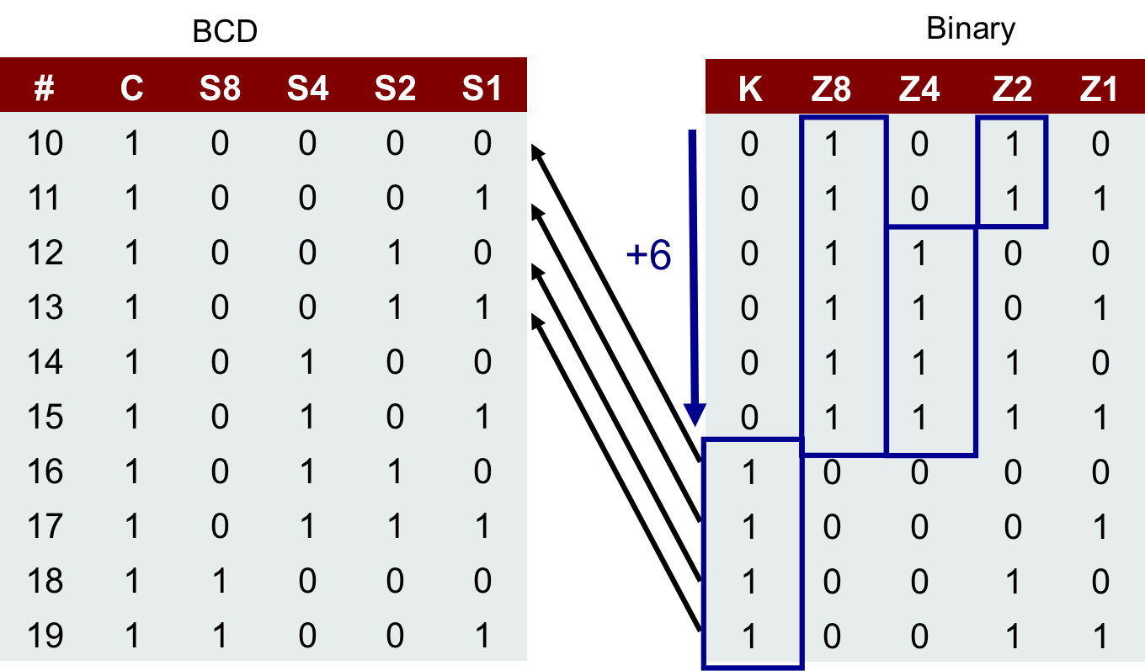
BCD Adder
A3
A2
A1
A0
B3
B2
B1
B0
C = K + Z8*Z4 + Z8*Z2
a3
a2
a1
a0
b3
b2
b1
b0
4-bit Adder
K
Cin
Cout
Cin
s3
s2
s1
s0
If C = 0
If sum is up to 9
S8 S4 S2 S1 = Z8 Z4 Z2 Z1
Else
S8 S4 S2 S1 = Z8 Z4 Z2 Z1 + 0110
0
0
z8
z4
z2
z1
If C = 1
a3
b3
b2
b1
b0
4-bit Adder
a2
a1
a0
0
Cout
Cin
s3
s2
s1
s0
C
s8
s4
s2
s1

Slide 26
Today’s Objective
To understand how to design and use an adder

